Slide 1
INTRODUCTION TO
ORDINARY REGRESSION

Slide 2
TWO KINDS OF STATISTICAL ANALYSIS
Dependent Variable Techniques
Ordinary Regression
Logistic Regression
Cox Regression
Poisson
Discriminate Analysis
Trans Reg
Simultaneous Equations
Inter-Relationship- Techniques
Factor Analysis / Principal Components
Segmentation
CHAID
K-Means
LCA

Slide 3
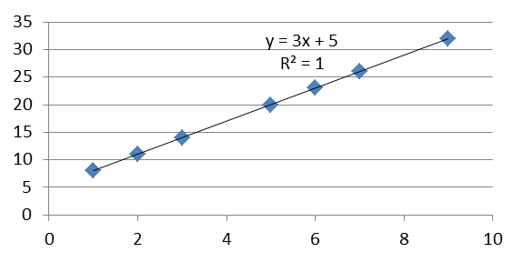
DEPENDENT VARIABLE TECHNIQUES
This is the start of dependent variable techniques
George Box: “All models are wrong. Some models are useful.”
The point of these techniques is that a certain variable DEPENDS on other variable(s)
The dependent variable depends on the independent variables
Both the (m) slope and the (b) intercept are constant / fixed numbers
Y = mX + b
This is the equation of a straight line . Every Y value EXACTLY is equal to the formula
Y DEPENDS on:
the movement of X (the independent variable) as well as
a slope coefficient and a constant intercept
x | y
1 | 8
2 | 11
3 | 14
5 | 20
6 | 23
7 | 26
9 | 32
b= | 5
m= | 3

Slide 4
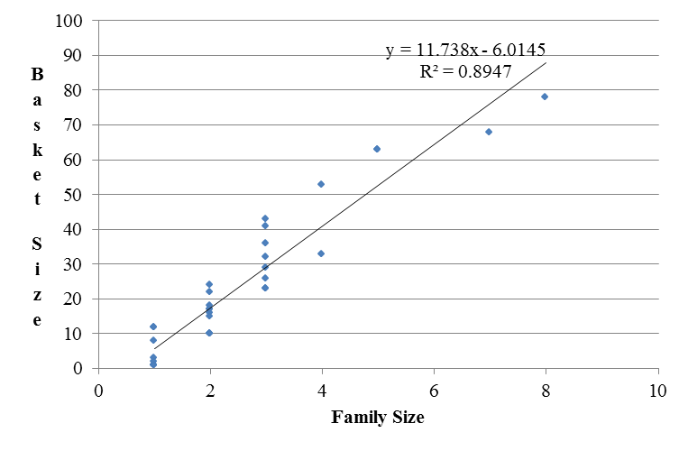
In statistics we are interested in the variation of Y GIVEN a variation of X
Y = b + mX + e
where e is some unknown random variables(s) causing X to vary
There may be several values of X that are the same, but a different value of Y is produced
So we want to know ON AVAERAGE how does Y DEPEND on the movement of X
We still want to fix as constants the slope coefficient (beta) and the constant intercept (alpha)
There are several criteria of how to do this, how to fix the constants
Ordinary regression uses “minimize the sum of the squared errors” to calculate the beta and alpha constants
The “best line” is that which minimizes the sum of the squared residuals / errors
So now it’s all about how to estimate the alpha intercept and the beta slope coefficients
An estimator is a mathematic formulation derived from a sample that produces a numerical result
Y = a + BX_{i}
Y is the predicted dependent variable
X is the independent variable
a is alpha, the constant / intercept
B is beta, the slope coefficient

Slide 5
THE ASSUMPTIONS OF ORDINARY REGRESSION
Much of econometrics is testing / diagnosing and correcting a violations of one or more of these assumptions
The above estimators are each unique to each estimating situation
Based on the estimating problem and given data, the proposed estimator varies in application
Assumption 1
The dependent variable can be calculated as a linear function of a specific set of independent variables, plus a disturbance term
Violations of this assumption are called specification errors
WRONG REGRESSORS
The omission of relevant independent variables or the inclusion of irrelevant independent variables
NONLINEARITY
The relation between the dependent and independent variables is NOT linear
CHANGING PARAMETERS
The parameters do not remain constant
Assumption 2
The expected value of the disturbance term is zero—the mean of the disturbance term is drawn is zero
BIASED INTERCEPT

Slide 6
Assumption 3
The disturbance terms are spherical
**HOMOSKEDASTICITY
The disturbance terms do not have the same variance
This is usually in survey data
**AUTO / SERIAL CORRELATION
The disturbance terms are correlated with each other
This is usually in time series data
Assumption 4
Non-stochastic X—the observations on the independent variables are considered fixed in repeated samples
ERRORS IN VARIABLES
Errors in measuring the independent variables
AUTOREGRESSION
Using a lagged value of the dependent variable as an independent variable
Only in time series
**SIMULTANEOUS EQUATION ESTIMATION
The dependent variable of one equation is the independent variable in another equation
The dependent variables are determined by a simultaneous interaction of several relationships
Assumption 5
**No perfect collinearity
Not exactly an assumption, but the mathematical requirement of having the number of observations be greater than the number of independent variables and that there is no exact linear relationship between the independent variables
We do not usually find perfect collinearity
We often find “near perfect” collinearity

Slide 7
These are the violations of assumptions we’ll deal with:
ASSUMPTION | Disturbance are uncorrelated | Disturbances have uniform variance | No near exact relationship with indep var | Ind var are fixed in repeated samples
VIOLATION | Auto regression / serial correlation | Heteroskedasticity | Near collinearity | Simultaneous equations
CONSEQUENCES | Parm est UNBIASED but ineff , BIASED se (downward) | Parm est UNBIASED but ineff , BIASED se and inconsistent | Parm est UNBIASED but ineff / large se, Reversed sign, High R 2 / low t-ratios | Parm est BIASED and inconsistent
DIAGNOSTICS | Durban Watson | Plot X by e, Park, Goldfeld-Quant and Breusch-Pagan test | Corr matrix, VIF, condition index | Multiple equations
CORRECTION | Cochran Orcutt procedure | WLS | Factor, ridge regression, drop var | Simultaneous estimation

Slide 8
CUSTOMER DATABASE
MODEL OUTPUT
SCORING
CUST | UNITS | PRICE | # DM
1000 | 50 | $10.25 | 9
1002 | 45 | $10.40 | 7
1004 | 41 | $11.02 | 7
1006 | 37 | $10.75 | 0
1011 | 30 | $10.91 | 6
1013 | 28 | $11.11 | 4
1015 | 21 | $11.28 | 0
1017 | 19 | $11.41 | 2
PARM | ESTIMATE
CONSTANT | 262.2343
PRICE | -21.2771
#DM | 0.772392
CUST | PRED
1000 | 51.10
1002 | 46.28
1004 | 33.17
1006 | 33.51
1011 | 34.71
1013 | 28.94
1015 | 22.30
1017 | 21.01
Y = a + Bxi
51.10 = 262.2343 + (-21.2771 * 10.25) + (0.772392 * 9)

Slide 9
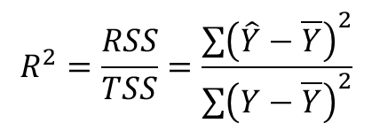
Y = a + BXi
actual
ESS
pred
TSS
RSS
ybar
mean
Xi

Slide 10
What Drives Hospital Units?
Actionable (Controllable)
Non-controllable / Exogenous
We wish to assess hospital-level unit drivers’ impact on both initial and repeat visit units; and, also to differentiate them based on whether they are controllable or non-controllable
Primary Relationship
Secondary Relationship
CX: Customer Service
Competitor Marketing Spend
CLIENT Marketing Spend
Lead Conversion
CX: Clinical Quality
Employee Engagement and Performance
Hospital Appearance/Location
Lead Generation
Shelter Partnerships
CX: Operational Efficiency
Word of Mouth / Social Media
INITIAL
VISIT
UNITS
REPEAT
VISIT
UNITS
Brand Equity / Advocacy
Patient Penetration
Economic Trends
“Winnable” Market
CRM Campaigns / Loyalty Programs
Competitive Density
Pricing
Local Demographics

Slide 11
The REG Procedure
Model: MODEL1
Dependent Variable: spend_per_txn
Number of Observations Read | 5063
Number of Observations Used | 5063
Important if missing observations
Analysis of Variance
Source | DF | Sum of Squares | Mean Square | F Value | Pr > F
Model | 5 | 2,404,070 (RSS) | 480,814 | 1,107.87 | <.0001
Error | 5057 | 2,196,140 (ESS) | 434
Corrected Total | 5062 | 4,600,211 (TSS)
Model MSE / Error MSE,
Explained / unexplained
# ind vars
# tot obs
less # ind vars
less int
If signif, the model is
better than random
# tot obs
less int
Std dev of error
Root MSE | 29.81 | R-Square | 0.5226
Dependent Mean | 52.06 | Adj R-Sq | 0.5221
Coeff Var | 57.27
1-(1-R²)*[(n-1)/(n-k-1)]
ALWAYS USE!
Root MSE /
Dep mean

Slide 12
Parameter Estimates
Variable | Parameter Estimate | Standard Error | t Value | Pr > |t|
Intercept | 64.64 | 5.281 | 12.24 | <.0001
tenure | -0.57 | 0.079 | -7.28 | <.0001
campaigns | 0.1091 | 0.123 | 0.89 | 0.3749
hhincome | 0.009 | 0.003 | 2.92 | 0.0035
opens | -15.55 | 4.441 | -3.51 | 0.0003
clicks | -32.42 | 26.43 | -1.27 | 0.2185
Significance?
Interpreting impact?

